Slide 1
Online News Portal
A Project Report
By
Susil Poudel: 35
Himal Poudel: 16

Slide 2
Introduction
Online platform to access news.
Instant news updates.
Personalized news content.
Allows subscribers to express their views.

Slide 3
Problem statement
Transportation time for paper based newspapers.
Timely updates of news to subscribers are not possible.
Personalized content delivery is not possible.
Interaction with the portal to publish subscriber’s views on news is not easy.

Slide 4
Objectives
To manage the details of latest news, interviews, advertisement and media.
To provide customized news to subscribers based on their interest.
To allow subscribers to express their views on news through means of comments.

Slide 5
Algorithms used
Depth First Search (DFS)
DFS algorithm is used to list comment threads on news.
Logistic Regression
It is used to predict the category of news given its heading and content.
Helps in automation

Slide 6
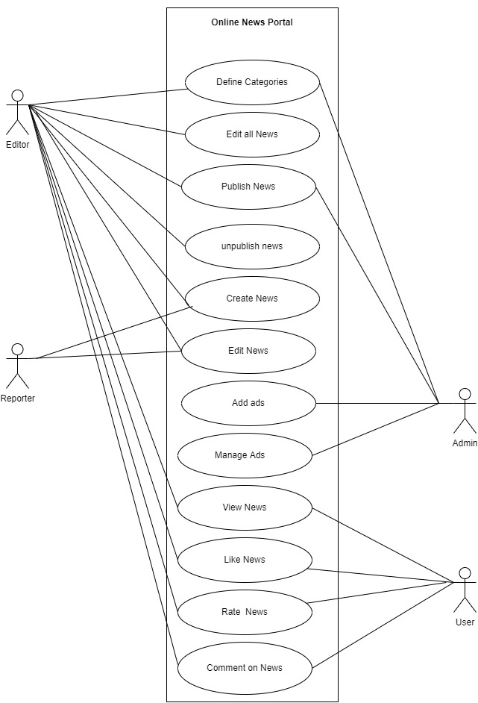
Use Case Diagram

Slide 7
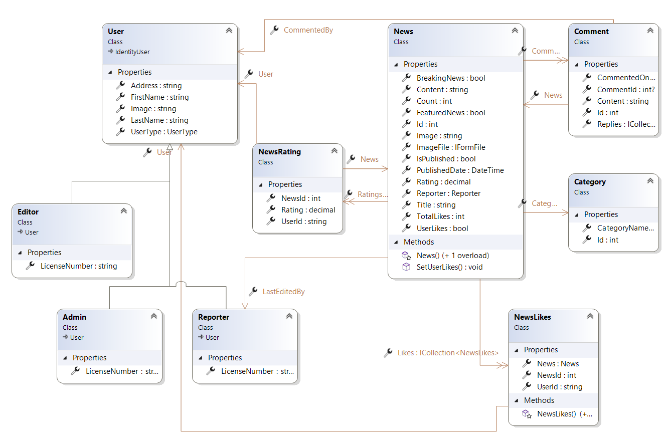
Class Diagram

Slide 8
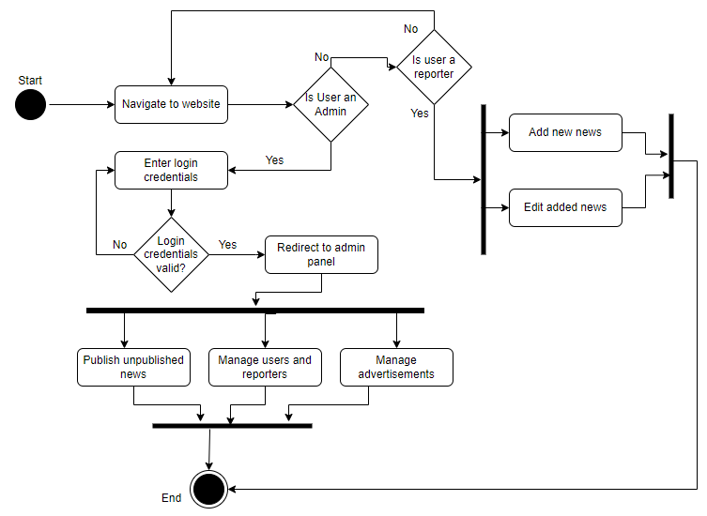
Activity Diagram

Slide 9
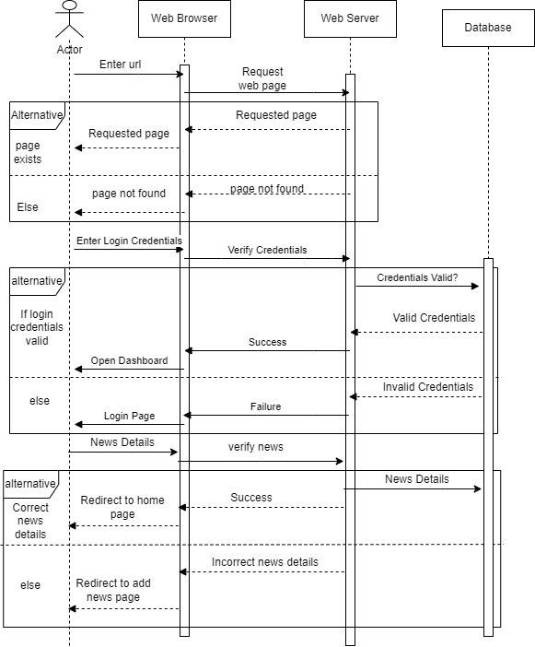
Sequence Diagram

